Slide 1
Azure IOT Hub Overview
Michael Chi
Technical Evangelist

Slide 2
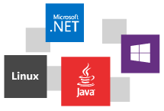
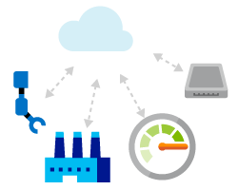

Azure IoT Hub
Connect Devices bi-directionally to Azure IoT Services
Receive / Send messages from / to millions of devices concurrently
Control & Monitor Devices
Add / Remove and Enable / Disable devices
Store device information (meta-data)
Per-device Authentication and Authorization

Slide 3
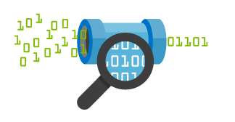

IoT Hub : the Azure IoT Cloud Gateway
Your IoT Hub
Event processing
(hot and cold path)
Device
Device ID
D2C receive endpoint
D2C send endpoint
Device business logic,
connectivity monitoring
C2D queue
endpoint
C2D send endpoint
Field GW/
Cloud GW
Msg feedback and monitoring endpoint
Device …
Device …
Device provisioning and management
Device identity management
Device …
IoT Hub management

Slide 4
IoT Hub : features
Connection
bidirectional comunication
reliable & secure channel
per-device authentication
multiplexing
Features
device to cloud telemetry
cloud to device commands and notifications (with TTL & feedback)
bulk uploads/downloads
monitoring devices (connection, activity, ...)
multi protocols (AMQP, HTTP) → IoT Protocol Gateway (MQTT)

Slide 5
IoT Hub : features
Features
Device management
Device twin
Device jobs
Device queries

Slide 6
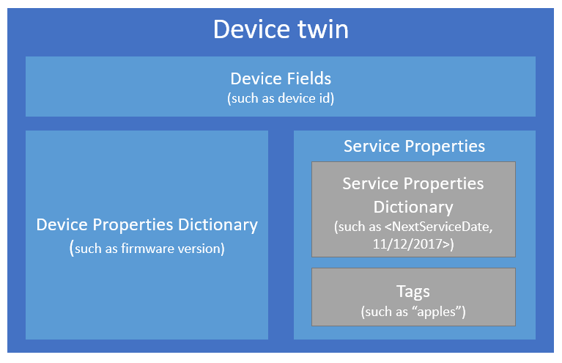
Device Twin
Notes:
其中一個服務屬性範例是 <下一個服務日期, 11/12/2017>

Slide 7
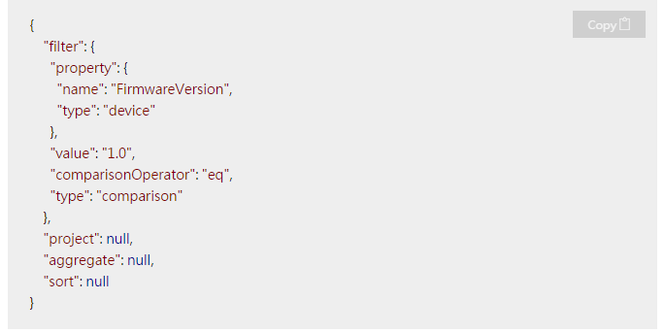
Device Query
Notes:
若要使用服務屬性或裝置屬性來查詢裝置對應項，您可以使用 JSON 查詢運算式。下列範例示範如何使用具有索引鍵 FirmwareVersion 和值 1.0 的裝置屬性來查詢所有裝置。您可以看到屬性的「類型」為「裝置」，這表示我們是根據裝置屬性進行查詢，而非服務屬性︰

Slide 8
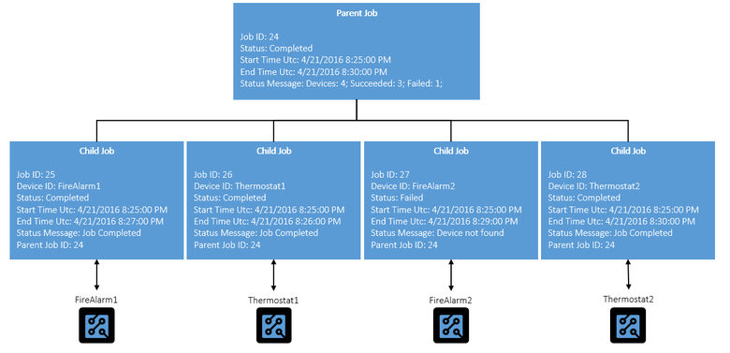
Device Job
Notes:
裝置作業
裝置管理的下一個概念是裝置作業，可協調多個裝置上的多步驟協調流程。
Azure IoT 中樞裝置管理目前提供六種類型的裝置作業 (我們會在客戶需要其他作業時新增作業)：
韌體更新：更新實體裝置上的韌體 (或 OS 映像)。
重新啟動：重新啟動實體裝置。
恢復出廠預設值：將實體裝置的韌體 (或 OS 映像) 還原為儲存在裝置上的原廠提供備份映像。
組態更新：設定實體裝置上執行的 IoT 中樞用戶端代理程式。
讀取裝置屬性︰取得實體裝置上裝置屬性的最新值。
寫入裝置屬性︰變更實體裝置上的裝置屬性。

Slide 9
TODO: Add IOTHub Device Mnagement
IoT Hub Device Management
Notes:
Gateway SDK :https://github.com/Azure/azure-iot-gateway-sdk/blob/master/doc/getting_started.md

Slide 10

IoT Hub for developers : SDKs
For devices and field gateway
Platforms
Windows
Linux
RTOS (freeRTOS), ARM mbed
Android, iOS
Languages
C#, C, Java, JavaScript (NodeJS)
For back-ends and cloud gateway
Languages
.Net C#
Java
JavaScript (NodeJS)
https://github.com/Azure/azure-iot-sdks
AMQP, MQTT and HTTP directly !!

Slide 11
Azure IoT Suite SDKs
Device-facing
For devices and field gateway
Platforms
RTOS (TI-RTOS)
Linux (Ubuntu, Debian, Fedora, Raspbian)
Windows 7/8/10
ARM mbed
Languages
C (C99 compliant), Java, C#, Node, Python
Service-facing
For back-ends and cloud gateway
Languages
.NET C#
Java
Node
https://github.com/Azure/azure-iot-sdks
AMQP, MQTT and HTTP directly !!

Slide 12

IoT Hub for developers : Hardware
Raspberry Pi 2
MinnowBoard Max
Dragonboard 410C
Freescale FRDM-K64F
TI CC3200
...
...
Your board !!

Slide 13
Identity, Authentication & Security
Identity
devices registry
provisioning APIs (create, delete, ...)
monitoring (connection status, activity, ...)
Authentication
permission (r-only registry, r/w registry, device, service)
policy made with one or more permissions
per-device auth with SAS token (from device id and device key)
Security
encrypted channel → SSL/TLS protocol

Slide 14
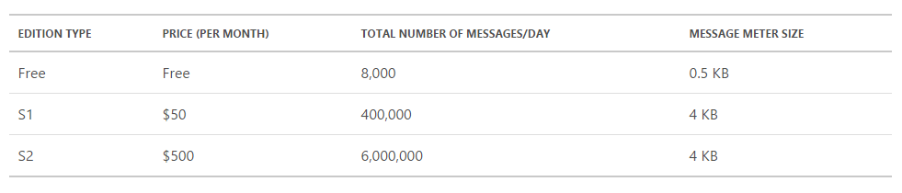
Prices, Quotas & Throttling
prices based on :
IoT Hub units (up to 200 or ... contact Microsoft Support)
number of devices
total number of messages/day
messages billed as 16 KB chunk
throttling based on identity registry ops, device connections, D2C & C2D operations
Notes:
Throughput (S2) = 23 GB/day/1 unit of IoT Hub
Scale Upto 200 Units of IoT Hub
=> 46000 GB/day i.e. 46 TB/day
2 - 32 Partitions - determine Read Parallelism
# of Partitions has no impact on PRICE!
So you can start with more! say 16 Partitions
Resource Group is a Logical Container for IaaS, PaaS, SaaS
1. Create IoT Hub
2. Create Device Identity (API) (unique Key per device)
3. Create Device Agent to send Device-to-Cloud Messages
4. Send Cloud-to-Device Messages
5. Send Messages from Stream Analytics to BLOB
6. Send Messages from Stream Analytics to Power BI (powerbi.com)
Device Agent can run on each device or just the field gateway
- Device (Agent) -> IoT Hub
- Device -> Gateway (Agent) -> IoT Hub
Transparent Gateway
=> 1 key used by Gateway + 1 key used for each device
=> Each device can be "White-Listed" by IoT Hub for Provision/De-Provision
=> 2 Way Authentication between Device and IoT Hub
=> Throttling is at Device Level (each device gets dedicated throughput channel with IoT Hub)
Opaque Gateway => 1 Key used by Gateway
=> 1 key used by Gateway (no key for device)
=> No "White-Listing"
=> 2 Way Authentication between Gateway and IoT Hub
=> Provision/De-provision handled by Gateway
=> Throttling is at Gateway Level (all devices share throughput channel with IoT Hub)
How you choose between 2 approaches?
- Depends of Volume of data you are sending to IoT Hub
- High Frequency, Lots of Concurrent Devices => Transparent Gateway
- Low Frequncy, Less Concurrency => Opaque Gateway
Note: Transparent Gateway also means you have GOOD Internet Connection
Power BI On-Prem Connectivity
- DIRECT Connection to SSAS (Tabular or Multi-dimensional)
- Data Management Gateway
e.g. RDBMS -> Excel / PBI Designer Report (PowerQuery Connection) -> PBI Gateway (on-prem) -> PBI.COM

Slide 15
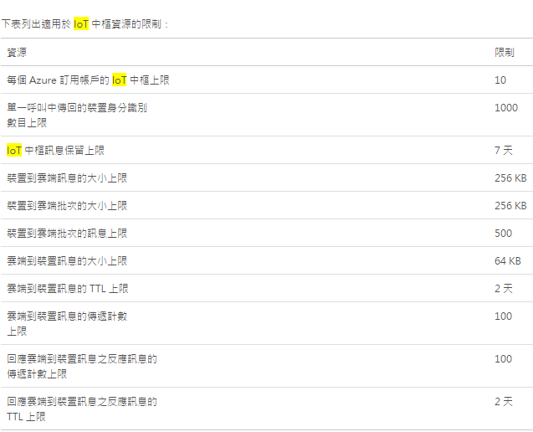
https://azure.microsoft.com/zh-tw/documentation/articles/azure-subscription-service-limits/

Slide 16
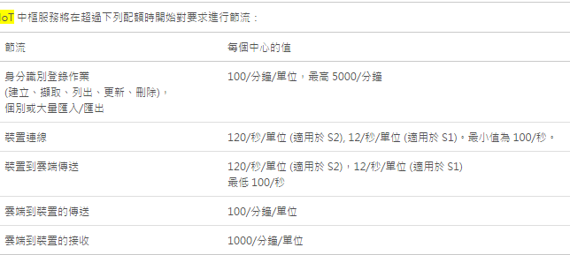

Slide 17
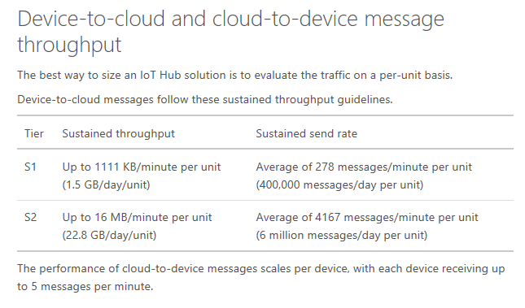
https://azure.microsoft.com/en-us/documentation/articles/iot-hub-scaling/

Slide 18
DEMO
Portal experience
Tools – Device Explorer

